Slide 1
SQL for PostgreSQL
황종필

Slide 2
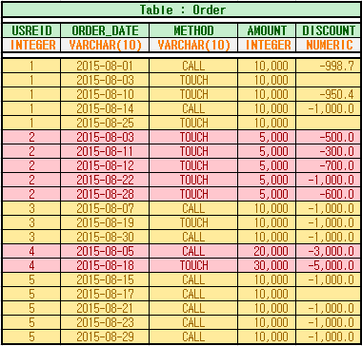
예시 데이터(테이블)

Slide 3
SQL - 1
회원의 첫 주문일자와 마지막 주문일자를 알고 싶다.
select userid
, min(order_date) as first_order_date
, max(order_date) as last_order_date
from "order"
group by userid
order by userid
;

Slide 4
SQL - 2
회원의 첫 주문일자와 마지막 주문일자의 간격을 알고 싶다.
select userid
, to_date(max(order_date), 'YYYY-MM-DD') - to_date(min(order_date), 'YYYY-MM-DD') as order_range
, min(order_date) as first_order_date
, max(order_date) as last_order_date
from "order"
group by userid
order by userid
;

Slide 5
SQL - 3
회원별 TOUCH와 CALL 주문수를 알고 싶다.
select userid
, count(userid) as total_orders
, count(case when method = 'TOUCH' then userid end) as touch_orders
, count(case when method = 'CALL' then userid end) as call_orders
from "order"
group by userid
order by userid
;

Slide 6
SQL - 4
회원별 TOUCH와 CALL 전체주문금액을 알고 싶다.
select userid
, sum(amount) as total_amount
, sum(case when method = 'TOUCH' then amount end) as touch_amount
, sum(case when method = 'CALL' then amount end) as call_amount
from "order"
group by userid
order by userid
;

Slide 7
SQL - 5
회원별 TOUCH와 CALL 평균주문금액을 알고 싶다.
select userid
, avg(amount)::integer as total_amount_avg
, avg(case when method = 'TOUCH' then amount end)::integer as touch_amount_avg
, avg(case when method = 'CALL' then amount end)::integer as call_amount_avg
from "order"
group by userid
order by userid
;

Slide 8
SQL - 6
회원별 TOUCH와 CALL 전체주문금액(할인된)을 알고 싶다.
select userid
, sum(amount + coalesce(discount, 0)) as total_amount_discount
, sum(case when method = 'TOUCH' then amount + coalesce(discount, 0) end) as touch_amount_discount
, sum(case when method = 'CALL' then amount + coalesce(discount, 0) end) as call_amount_discount
from "order"
group by userid
order by userid
;

Slide 9
SQL - 7
8월 11일에서 8월 20일까지 주문이 2개 이상인 회원을 알고 싶다.
select userid
, count(userid) as orders
from "order"
where order_date between '2015-08-11' and '2015-08-20'
group by userid
having count(userid) >= 2
;

Slide 10
SQL - 8
8월 10일을 포함한 향후 10일간의 전체주문금액(할인된)이 2만원 이상인 회원을 알고 싶다.
select userid
, sum(amount - coalesce(discount, 0)) as amount_discount
from "order"
where order_date between '2015-08-11'
and to_char(to_date('2015-08-11', 'YYYY-MM-DD') + '9 days'::interval, 'YYYY-MM-DD')
group by userid
having sum(amount - coalesce(discount, 0)) >= 20000
;

Slide 11
SQL - 9
8월 10일에서 8월 15일까지 주문한 회원수와 주문수를 알고 싶다.
select count(distinct userid) as users
, count(userid) as orders
from "order"
where order_date between '2015-08-10' and '2015-08-15'
;

Slide 12
SQL - 10
8월 10일에서 8월 15일까지 TOUCH와 CALL로 주문한 회원수와 주문수를 각각 알고 싶다.
select count(distinct case when method = 'TOUCH' then userid end) as touch_users
, count(distinct case when method = 'CALL' then userid end) as call_users
, count( case when method = 'TOUCH' then userid end) as touch_orders
, count( case when method = 'CALL' then userid end) as call_orders
from "order"
where order_date between '2015-08-10' and '2015-08-15'
;

